Slide 1
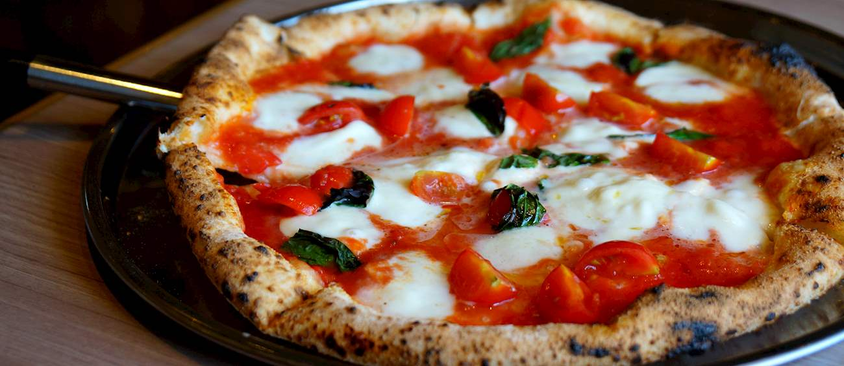
PIZZA IN NEW YORK OR SAN FRANCISCO?
By George C Kabwe

Slide 2

Introduction
We all love pizza! Right?
Research has shown that pizza is one of the most popular foods in the world as ranked by Taste atlas and other researchers.
This project focuses on comparing pizza places in New York to San Francisco.
Imagine your choice of which city to visit depends on which city has the best pizza. The decision is to choose a place with a high density of Pizza places as most of people love to change places where they eat pizza from until they find their best and favorite place. To solve this problem, an analysis of the Pizza stores’ locations in New York and San Francisco will be conducted to find the best place for anyone who loves changing pizza places and anyone who wants to find the best place from .

Slide 3
Data section
The FourSquare API was used to collect data about locations of Pizza stores in New York, NY and San Francisco, CA. These are two of the most populated US cities and they should contain some of the best Pizza places in the US.
The data obtained from FourSquare had the following columns:
Name of the pizza place
The Address of the place for people to quickly locate it
The Latitude and Longitude which was used for mapping the places.

Slide 4
Methodology
The target was to asses which city would have the highest Pizza store density. The Four Square API through the venues channel and Pizza CategoryID was utilized together with the near query to get venues in the cities.
The name and coordinate data was then plotted on the map for visualization.
Next, to get an indicator of the density of Pizza Places, the center coordinate of the venues was calculated to get the mean longitude and latitude values.
Then the mean of the Euclidean distance from each venue to the mean coordinates was also calculated as an indicator

Slide 5
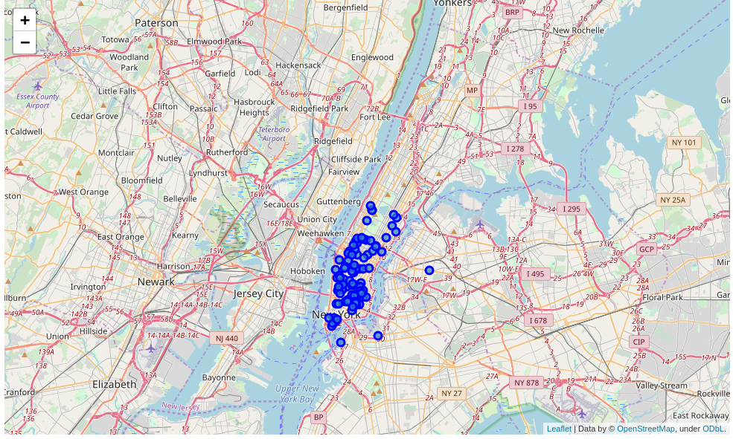
New York pizza places

Slide 6
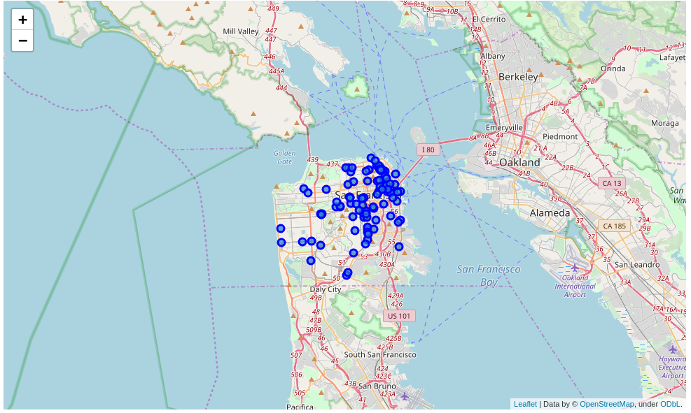
San Francisco pizza places

Slide 7
Visual analysis discussion
The visualization shows that New York and San Francisco all have multiple pizza places.
City | Number of Pizza Places
New York | 271
San Francisco | 167

Slide 8
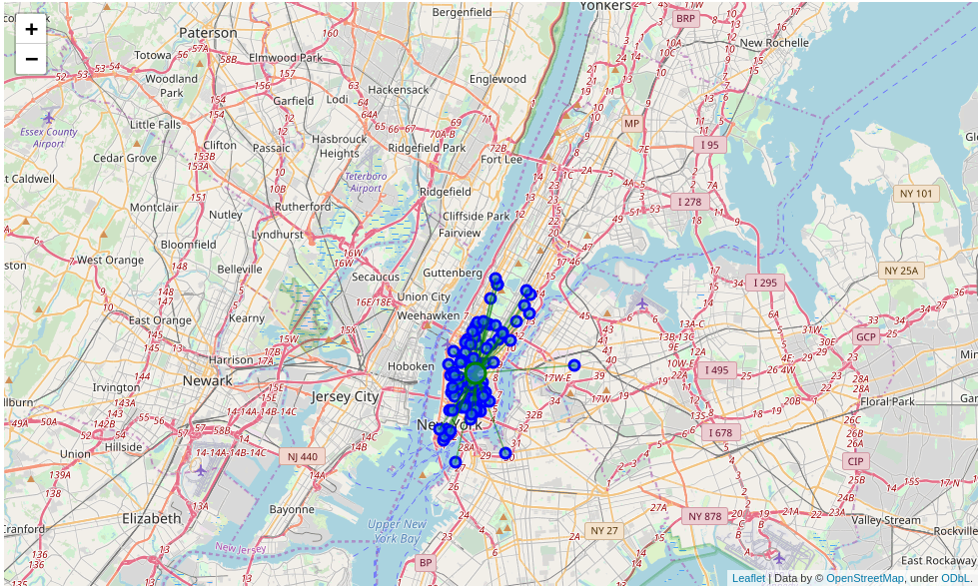
New York pizza places

Slide 9

San Francisco pizza places

Slide 10
results
On average New York’s top 100 Pizza places are 25% more dense than San Francisco
City | Mean Distance from centre
New York | 0.02296898464975578
San Francisco | 0.02880416941977326

Slide 11
discussion
It has been established that New York has its Pizza places more densely located as compared to San Francisco.
It can be therefore be concluded tthat New York is ranked as the best option in this comparison.

Slide 12
conclusion
An individual wishing to decide which city has pizza places close to each other can utilize these findings.
For future considerations, the pizza places can be ranked so and other information like availability of parking lots, children entertainment and other information can be gathered to better narrow down on which place one can choose

